Slide 1

Department of Information Technology ABES Engineering College, Ghaziabad, UP
MINI PROJECT PRESENTATION SESSION 2021-22
Name : Sachin Kumar Singh
Class & Section : IT-C
Roll No. : 2000320130137
Admission No : 2020B0131018

Slide 2


Weather Alert System with Python
Project Title
By: Sachin Kumar Singh
+

Slide 3
Contents:
About the company
Objective of course
Course overview
Project based learning
Challenges and limitation
Conclusion
Annexures:(a)Code snippets
(b)Certificate(s)
(c)Project Demo Snippets
(d)References

Slide 4

1) About the Company: Udemy
Udemy, Inc. is a for-profit massive open online course (MOOC) provider aimed at professional adults and students.
It was founded in May 2010 by Eren Bali, Gagan Biyani ,and Oktay Caglar.
The headquarters of Udemy is located in San Francisco, US, with hubs in Denver, US; Dublin, Ireland; Ankara, Turkey; Sao Paulo, Brazil; and Gurugram, India.

Slide 5
2) Objective of course
My course name is “The Python Mega Course by Ardit Sulce”
To learn Python programming language from the beginning.
To have knowledge of various python libraries like numpy, pandas,etc.
To get hands on various projects and making one of our own.
To learn skill of designing and building real-life programs.

Slide 6
3) Course overview
Firstly, I learnt the Python programming language from the very beginning.
All the basics of Python were covered in the course.
After the basics, some important libraries were focused upon in the course which were required in project making.
Important libraries that were taught : Pandas, Numpy and Tkinter.
There were total 10 real life projects discussed in the course.

Slide 7
4) Project Based Learning

Slide 8

A) Introduction to Python

Slide 9

Python is a widely used general-purpose, high level programming language.
It was created by Guido van Rossum in 1991 and further developed by the Python Software Foundation.

Slide 10
Python was designed with an emphasis on code readability, and its syntax allows programmers to express their concepts in fewer lines of code.
Python is a programming language that lets you work quickly and integrate systems more efficiently.

Slide 11
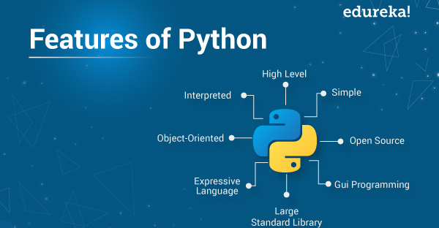

Slide 12
B) Project:Weather Alert System with Python
+

Slide 13
What is the project?
This weather alert system will send an email notification to single or multiple recipients when it forecasts that the sky will rain/snow in the next few hours or during any other heavy weather condition.
The email notification contains additional information such as the forecasted temperature and humidity.

Slide 14
Making:
1. Setup:
(a)Weather API: Openweathermap weather API
(b) Email Configuration
(c) Python modules
2. Implementation
(a) Call the weather API
(b) Receive the weather forecasting for set location
(b) Send an email notification to the concerned person with main detail like
temp,humidity.

Slide 15
Technologies used:
Python programming language.
Python libraries used: a)request
b)threading
c)time
d)smtplib
e)win10toast
Openweathermap API

Slide 16
5) Challenges & limitations
The major limitation of this project is that the API being used sometimes do not respond to the requests being made to it.

Slide 17
Future improvement:
Including earthquake warnings.
Including a website where we can see various other details of that particular location.
Adding more than one location.

Slide 18
6)Conclusion
This project gives much needed notifications during a heavy weather condition.
This project will help the user to make preparation changes according to the weather.
This project also help in knowing about various important libraries of python and also facilitate in using these libraries.

Slide 19
7)Annexures

Slide 20
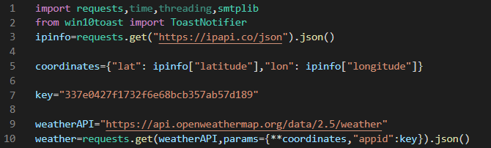
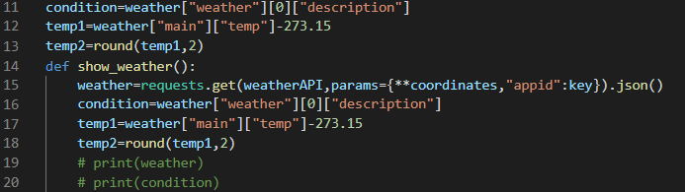
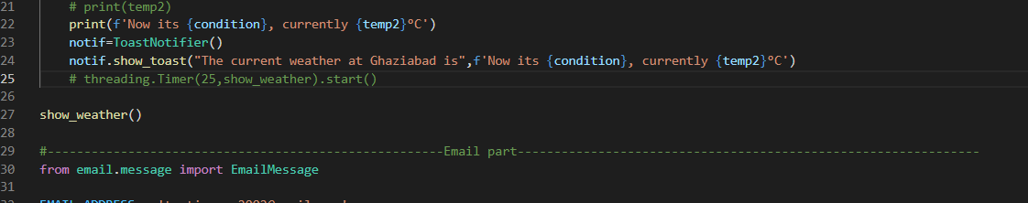
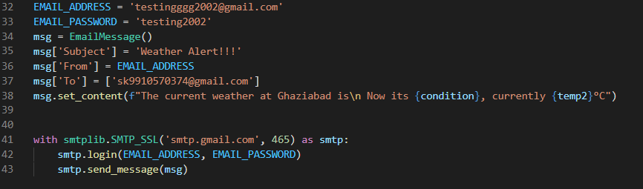
7a)Code Snippets

Slide 21

Certificate

Slide 22
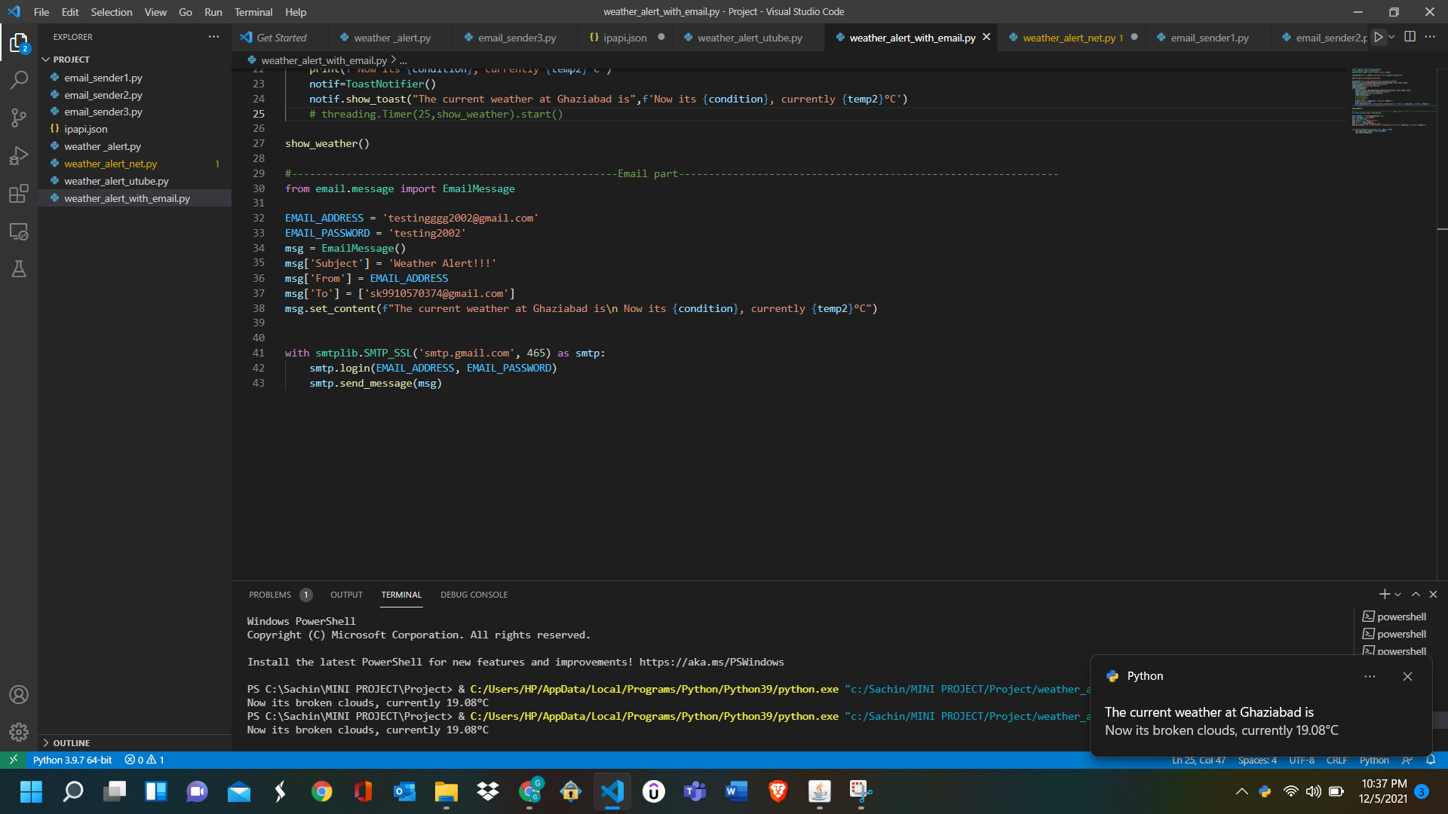
7c)Project Demo: Snippet 1

Slide 23
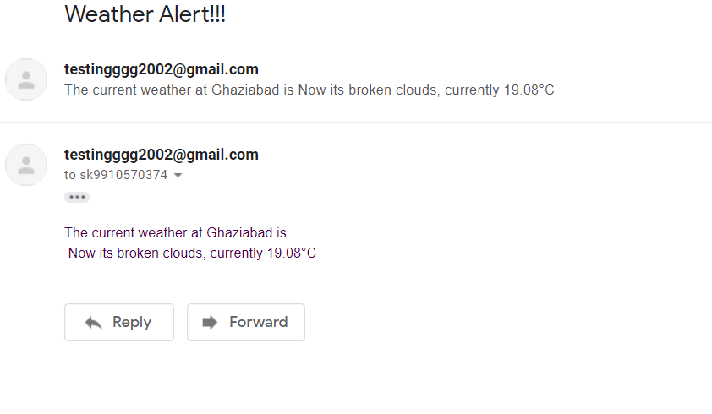
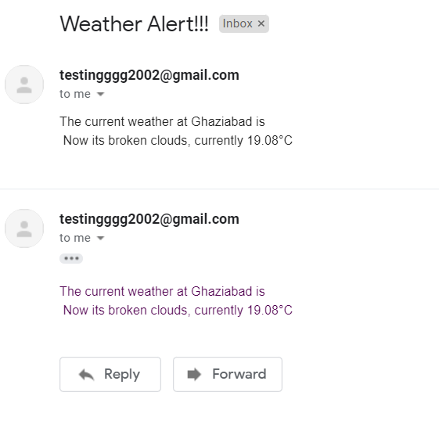
7c)Project Demo: Snippet 2
Sender ID
Receiver ID

Slide 24
7d)Reference:
How to Create A Weather Chatbot
Tips and Tricks for Handling Configuration Files in Python
https://towardsdatascience.com/how-to-create-a-weather-alert-system-in-python-5fab4b42e49a

Slide 25
Thank You

